Slide 1
August 9, 2016

Slide 2
Gilbert Regional Park -Presentation Outline
Input Summary
Concept Master Plan
Level of Service
Capital Improvement Plan (CIP) Transition
Analysis – 5 Key Interests
Recommended Changes and Results

Slide 3
Input Summary

Slide 4
Previous Park Programming Inputs
Parks & Recreation Master Plan (2014)
Top Five Activities: Playgrounds, Trails, Special Events, Swimming, Gym Fitness
Top Five Recreation Spending Priorities: Trails, Aquatic Facilities, Recreation Centers, Parks, Lighted Fields
Gilbert Community Survey (2014)
Most Important Potential Park and Recreation Offerings:
Trails, Year Round Aquatic Center, Sport Fields, Multi-Use Lake
Sports Fields Needs Assessment (2015)
37 Additional Fields for System Build Out

Slide 5
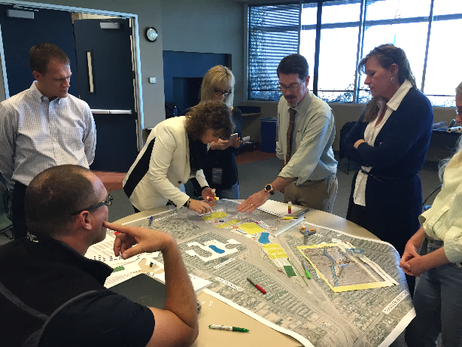
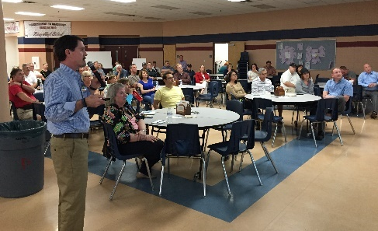
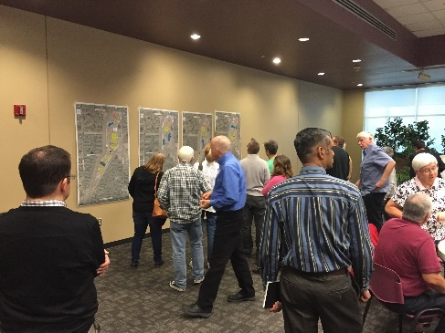
Community Outreach
Public Workshop Inputs
Focus Groups
Individual Interviews
Website
Workshops

Slide 6
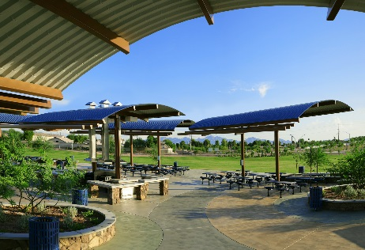
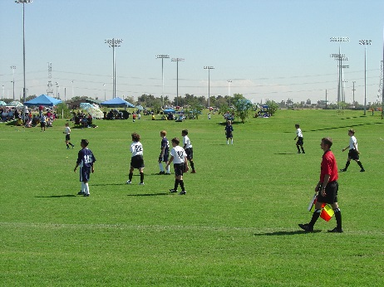
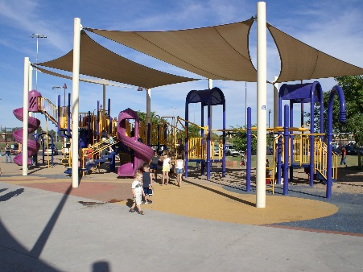
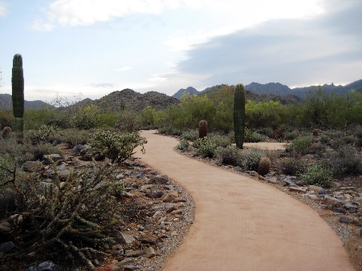
Top Amenities – All Input Methods
Multi-Use Trails
Sports Fields
Recreation Center
Picnic Ramadas
Fishing Lake
Aquatics Center
Amphitheater
Playgrounds
Splash Pad
Open Space

Slide 7
Concept Master Plan

Slide 8
Final Master Concept Plan

Slide 9
Level of Service

Slide 10
Recommended Minimum: 1070 acres ____________________________________ Now: 605 acres Need: 465 acres Available: 518 acres
10
Service Level Overview

Slide 11
11
Vacant Park Property | Acres
Chandler Basin Town owned | 47
Chandler Basin Recreation Easement | 225
Nichols Park | 11
Freestone Park | 32
Elliot District Park | 8
Greenfield Plant Buffer | 80
Rittenhouse Basin | 115
Total | 518

Slide 12
Capital Improvement Program (CIP) Transition

Slide 13
13
Removed CIP Projects | Potential Project Location at Gilbert Regional Park
PR076 – Special Events Center (SWC Germann/ Greenfield) (60A) | Multi-Use Center
PR083 – Riparian Area - South Recharge Site (68A) | Open Space and 7.1 Miles of Trails
PR087 – Southwest Activity Center/Field Complex (SWC Greenfield/Chandler Heights) (80A) | Recreation/Aquatic Center and Sports Fields
PR039 – Crossroads Park-Phase III (activity center) | Recreation/Aquatic Center

Slide 14
14
Related Project Still Remaining in FY17 CIP | Potential Project Location at Gilbert Regional Park
PR081 – South Area Pool (was Campo Verde, now states to coordinate with Gilbert Regional Park - PR031) | Pool Component of Recreation/Aquatic Center

Slide 15
Analysis – 5 Key Interests

Slide 16
5 Key Interests
1. Potential Partnerships/Sponsorships
2. Construction and Operations
3. Dirt Removal
4. Phasing and Timing of Sports Fields
5. Staffing Levels

Slide 17
Potential Partnerships & Sponsorships (in alphabetical order) | Partnership |  |  | Sponsorship
Amenity | Probable | Neutral | Not Probable | Probable | Not Probable
Amphitheater |  |  | X | X
Aquatics Center | X |  |  | X
Bike Park |  |  | X | X
Disc Golf |  |  | X | X
Dog Park |  | X |  | X
Great Lawn |  |  | X | X
Lake |  | X |  | X
Maintenance Building/Yard |  |  | X |  | X
Mountain Bike Skills Park |  | X |  | X
Multi-Use Center | X |  |  | X
Multi-use Paths |  |  | X | X
Parking |  |  | X |  | X
Pickleball Courts |  | X |  | X
Playgrounds |  |  | X | X
Ramadas |  |  | X | X
Recreation Center |  | X |  | X
Restroom Bldg. |  |  | X |  | X
Retail | X |  |  |  | X
Ropes Course | X |  |  | X
Signage |  | X |  | X
Skate Park |  |  | X | X
Splash Pad |  | X |  | X
Sport Fields |  | X |  | X
Tennis Courts |  |  | X | X
Trails |  |  | X | X
Volleyball Courts |  |  | X | X

Slide 18
Copper Sky - Construction
Opened March, 2014
98 acre regional park with recreation/aquatic center
$44.8M actual cost, not including $7M land cost, ($457,100/acre)
Escalator of 3% per year = approximately $47.5M ($484,700/acre)
No multi-use center or significant dirt removal costs associated with Copper Sky project
Construction Comparison | Copper Sky | Gilbert Regional
Total Cost | $47.5* Million | $120 Million
Cost per Acre | $485K* (actual) | $441K (budget)
* Adjusted for inflation

Slide 19
Concept Plan Estimated Operation Cost

Slide 20
Copper Sky Operations
Comparing applicable operating costs, the Multi-Use Center is removed from calculations:
Operations Comparison | Copper Sky (FY16 actual) | Gilbert Regional (Estimated)
Total Operating Cost | $ 4.22 M | $ 4.71 M
Total Revenue | $ 1.55 M | $ 3.52 M
Total Subsidy | $ 2.67 M | $ 1.19 M
Cost Recovery | 36.6% | 74.7%

Slide 21
Dirt Removal
Estimated cost to remove 2.5 million cubic yards is $33.6M
This cost incurred if Gilbert chooses to accelerate Phase 3 of Concept Plan

Slide 22
Phasing and Timing of Sports Fields
CURRENT |  | BUILD-OUT
Youth Baseball | 1 | Youth Baseball | 6
Adult Baseball | 3 | Youth Softball | 3
Soccer | 1 | Adult Softball | 2
Football | 1 | Soccer | 12
 |  | Football | 7
 |  | Cricket | 1
TOTAL | 6 | TOTAL | 31
Minimum of 6 fields needed at this time
Concept Plan show 17 total
Ample property for remaining 20 fields

Slide 23
Staffing Levels
Projections made from conceptual
Full analysis before considered by Council
Management and program options will be explored

Slide 24
Recommended Changes to the Concept Master Plan

Slide 25
Recommendations
Conceptual design layouts for remaining park properties
Coordinate system wide phasing approach:
Build Phase 1 at Gilbert Regional Park
Pursue development of six fields at alternative site
Determine remaining system-wide phasing options & plan revisions at future Council meeting(s)
Show Multi-use Center as public-private partnership place holder
Explore private/partnership solution for the aquatics center/pool
If private solution is not available, perform market feasibility study
Reflect recommendations in final Concept Plan & CIP

Slide 26
Results

Slide 27
Cost
PRMP
$194M to $120M
Explores Models
System Wide Approach & Flexibility
Park
FTE
Delivers South Gilbert 30 acre park (Phase 1)
Fields
40 to 30
Addresses current field needs

Slide 28
Motion
Consider motion to support approval of the Master/Concept Plan for Gilbert Regional Park with Recommended Changes

Slide 29
Thanks and Questions?

